Slide 1
#GH2035

Slide 2
Global Health 2035: The World Development Report 1993 at 20 Years
The World Bank’s World Development Report 1993
Demonstrated that evidence-based health expenditures are an investment not only in health, but in economic prosperity
The Lancet Commission on Investing in Health
25 economists and global health experts re-examined the case for investing in health, chaired by Lawrence H. Summers, former Chief Economist at the World Bank and Undersecretary for International Affairs of the U.S. Department of Treasury
Argued for additional resources for cost-effective interventions to address high-burden diseases
Proposes a health investment framework for low- and middle-income countries
Provides a roadmap to achieving gains in global health through a ‘grand convergence’

Slide 3
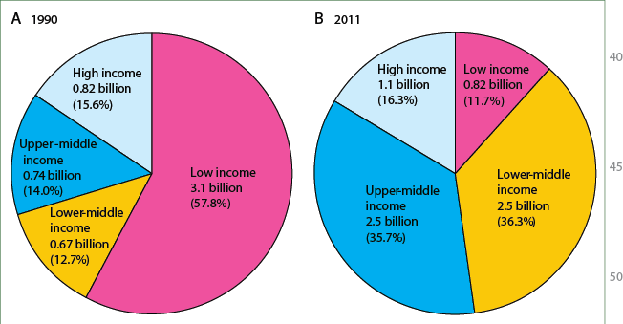
1993-2013: Extraordinary Economic Progress
Movement of populations from low income to higher income between 1990 and 2011

Slide 4
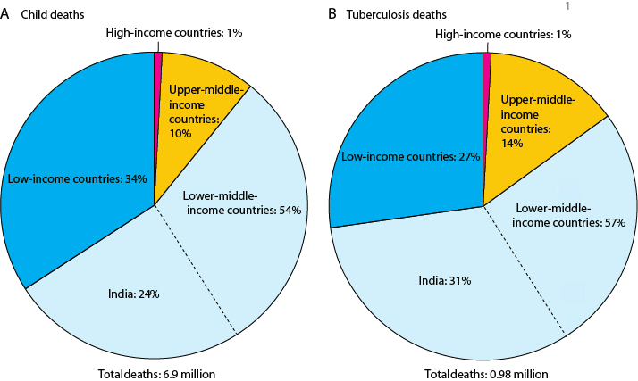
2013-2035: Global Health Challenges
Child deaths and infectious diseases by country income level, 2011
Worldwide distribution of child deaths and TB deaths by country income level

Slide 5
Global Health 2035: Key Messages
There is an enormous payoff from improvements in health.
A ‘grand convergence’ in health is achievable within our lifetime.
Fiscal policies are a powerful and underused lever for curbing of non-communicable diseases and injuries.
Progressive pathways to universal health coverage are an efficient way to achieve health and financial protection.

Slide 6
Full Income: A Better Way to Measure the Returns from Investing in Health
income growth
value of life years gained in that period
change in country's full income over time period
Across LICs and LMICs, health contributed to annual growth in full income by about 1.2% per year of the initial value of GDP for the period 1990–2000 and 1·8% per year in the period 2000–2011.
The economic benefits of convergence would exceed costs by a factor of about 9 in LICs and around 20 in LMICs.

Slide 7
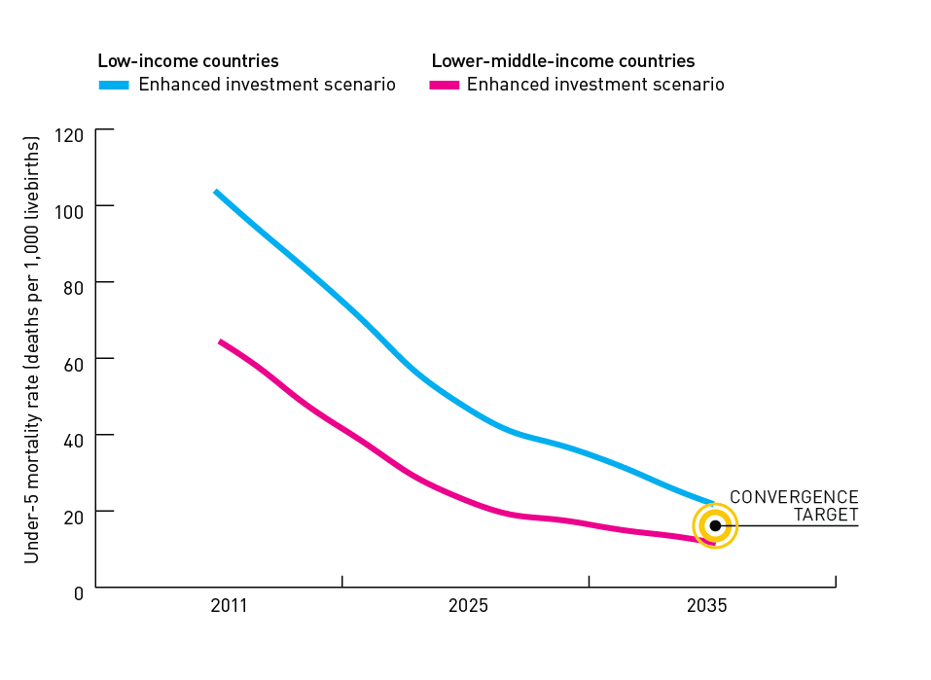
A Grand Convergence is Achievable by 2035
With enhanced investment,
we could achieve a
grand convergence in global health in the next generation – bringing deaths from infections and RMNCH conditions in LICs and MICs down to rates in the best-performing MICs.

Slide 8
Interventions Included in Convergence Model
RMNCH
Pregnancy related interventions; Abortion & complications; Family planning; Diarrhoea management; Pneumonia treatment; Immunisation; Nutrition
HIV
Prevention activities; Management of opportunistic infections; Care and treatment; Collaborative tuberculosis-HIV treatment
Tuberculosis
Diagnosis, care and treatment of drug-sensitive TB; Diagnosis, care and treatment of multidrug-resistant TB
Malaria
Treatment with appropriate drugs; Long-lasting insecticidal bed nets; Intermittent presumptive treatment in pregnancy
Neglected Tropical Diseases
Interventions to control: lymphatic filariasis, onchocerciasis, schistosomiasis, trachoma, soil-transmitted helminths

Slide 9
Financing Convergence
 | Scenario 1 (realistic scenario) | Scenario 2 (optimistic scenario)
Growth in domestic health spending from now to 2035, as a proportion of GDP | 2% → 3% | 2% → 4%
Allocation of this increase to the convergence agenda | 2/3 | 2/3
Incremental cost of convergence in the year 2035 | US $30 billion | US $30 billion
Contribution of domestic versus external financing in the year 2035 | Domestic: US $21 billion External: US $9 billion | Domestic: US $30 billion External: US $0

Slide 10
R&D: New Tools to Achieve Convergence
The international community should double its current R&D spending from $3 billion to $6 billion annually by 2020, with a focus on potentially game-changing vaccines, diagnostics and drugs.
 | Diagnostics | Drugs | Vaccines | Devices
Short term (available for use before 2020)
Important | Point-of-care diagnostics for HIV, TB and malaria; point-of-care viral load for HIV | New artemisinin coformulations for malaria; new TB drug conformulations ; curative drugs for hep C; new antivirals for influenza; long-acting contraceptive implant to reduce total fertility rate; safe, effective and shorter duration therapy for active and latent TB; new drugs for neglected tropical diseases (with high efficacy and few side-effects) | Moderately efficacious (50%) malaria vaccine; conjugated typhoid vaccine; staphylococcal vaccine; heat-stable vaccines; new adjuvantrs to reduce multiple dosing of vaccines; more effective influenza vaccines in elderly people |  | Self-injected vaccines
Potentially game-changing | -- | Single-encounter treatment for malaria: a one-dose cure for falciparum and vivax malaria | -- |  | --
Medium term (available for use before 2030)
Important | -- | Antimicrobials based on a new mechanism of action | Combines diarrhoea vaccine (rotavirus, entertoxigenic, Escherichia colityphoid, and shigella); protein-bases universal pneumococcal vaccine; respiratory syncytial virus vaccine; hepatitis C vaccine; HIV/AIDS vaccine; tuberculosis vaccine; highly efficacious malaria vaccine; universal influenza vaccine |  | --

Slide 11
Substantial Reduction in NCDs and Injuries by 2035
Inexpensive population-based and clinical interventions could reduce additional deaths from NCDs and injuries
Fiscal policies are a promising and underused lever, especially tobacco taxation and reducing fossil fuel subsidies
Policy Instruments
 | Price changes (taxes and subsidies) | Laws and regulations | Information and communication | Improved built environment
Tobacco use | Large (170%) excise taxes* | Bans on use in public places and on promotion* | Mass media messages* | --
Alcohol use | Large taxes in countries with high burden of alcohol consumption* | Bans on promotion and restrictions on sales* | Mass media messages* | --
Poor diet | Tax sugar and potentially other foods | Bans on salt and transfats in processed food* | Increase public awareness of healthy diet and physical activity* | --
Unsafe roads and vehicles | -- | Enforce speeding and drink-driving laws | -- | Safe roads and vehicles
Air pollution | Reduce coal and petroleum energy subsidies. Selectively subsidise LPG to replace kerosene. Tax sources of ambient pollution | Promote LPG use | -- | --

Slide 12
Progressive Universalist Pathways to UHC Protect the Poor from the Outset
Pathways toward universal universal health coverage

Slide 13
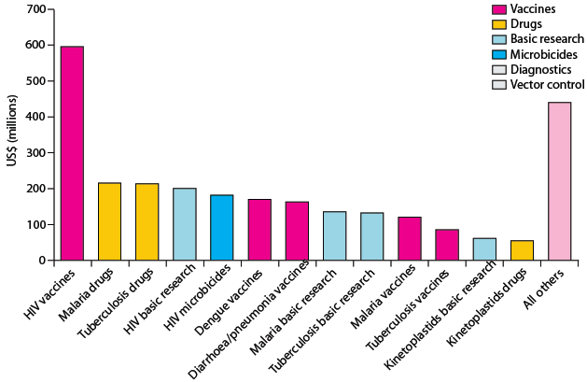
Opportunities for International Collective Action
Best way to support convergence is funding development and delivery of new health technologies R&D targeted at diseases disproportionately affecting LICs and LMICs
and managing externalities such as pandemics.
These core functions have been neglected in the last 20 years.

Slide 14
Launch & Advocacy Plans
Target audiences: Post-2015 decision-makers; finance and health ministers from LICs and lower MICs; donor agencies and multilateral banks; global health advocates; global health academia; private sector and corporate leaders.
Phase I | Phase II
Teleconference with global health advocacy community, Nov 25 Global launches in London, Johannesburg and Tunis, Dec 3 UCSF launch with Bay Area philanthropists, Dec 17 Event with select Commissioners around Open Working Group meetings , Jan 2014 WEF panel event in Davos, Jan 2014 | Side event, 3rd Session of the Intergovernmental Committee of Experts on Financing the SDGs, Mar 2014 Side event at the African Health Economics Association Meeting, March 2014 Side event, World Bank spring meetings, April 2014 Side event at the African Development Bank meeting in Kigali targeting African Finance Ministers, May 2014 Capitol Hill briefing, held at CGD, date TBC UK Parliamentary briefing, date TBC Additional events in target countries hosted by Commissioners and advocacy groups, TBC Additional briefings for development agencies, banks and academia hosted by Commissioners, TBC

