Slide 1
Investing in Health:
What is the Role of Health Aid?
Lawrence H. Summers
Charles W. Eliot University Professor, Harvard University
Dean T. Jamison
Professor Emeritus, University of California, San Francisco
Center for Global Development
October 21, 2015

Slide 2
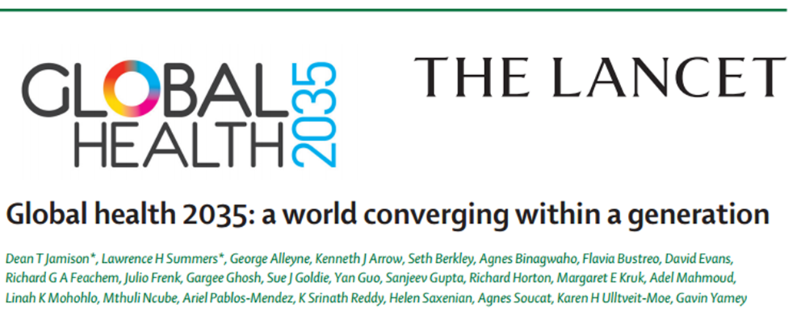

Slide 3
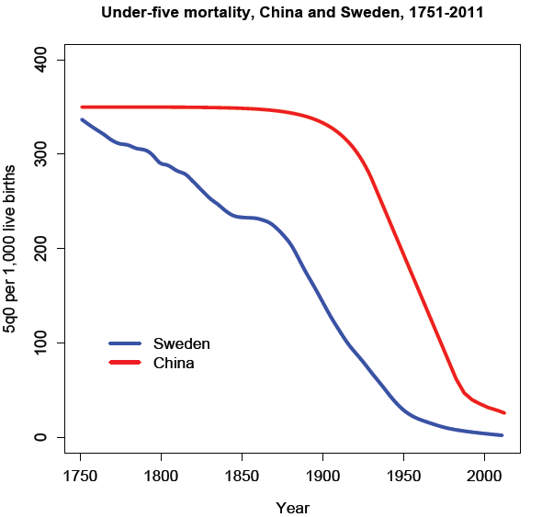
Convergence, divergence, and a second convergence

Slide 4
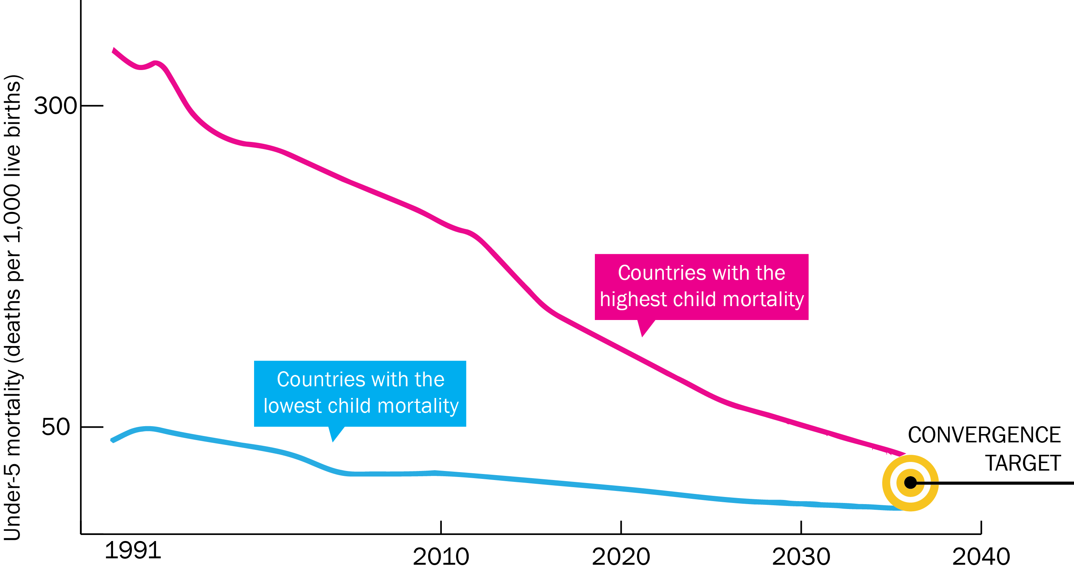
Now on cusp of a historical achievement:
Nearly all countries could converge by 2035

Slide 5
Sources of income to fund convergence
Economic growth
IMF estimates low- and lower middle-income countries will add $9.6 trillion/y to GDP from 2015-2035
Mobilization of domestic resources
Taxation of tobacco, alcohol, sugar, extractive industries
Inter-sectoral reallocations and efficiency gains
Development assistance for health
Cost of convergence ($70 billion/y) is less than 1% of anticipated growth
Redirection of fossil fuel subsidies to the health sector, health sector efficiency
Subsidies account for 3.5% of GDP on a post-tax basis
Will still be crucial for achieving convergence
The nature of DAH will need to evolve – more emphasis on R&D, pandemic preparedness and other “global” functions

Slide 6

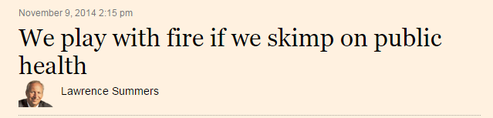
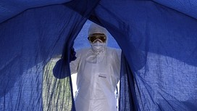
Ebola was a ‘stress test’ on health systems

Slide 7
Poverty and disease burden now predominantly in middle-income countries
About three quarters of the world’s poor now live in middle-income countries.
Three middle-income countries account for almost half of the world’s extreme poor (India, Nigeria, and China).
70% of the global burden of disease is now located in middle-income countries.

Slide 8
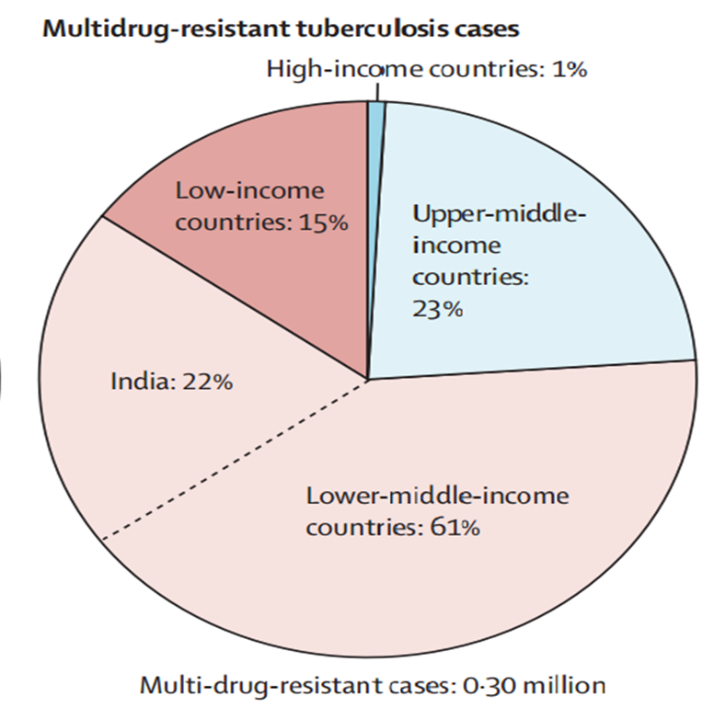
Multidrug-resistant tuberculosis is predominantly a middle-income country problem
Worldwide distribution of multidrug-resistant tuberculosis cases by country income level, 2011
Total multidrug-resistant cases:
300,000

Slide 9
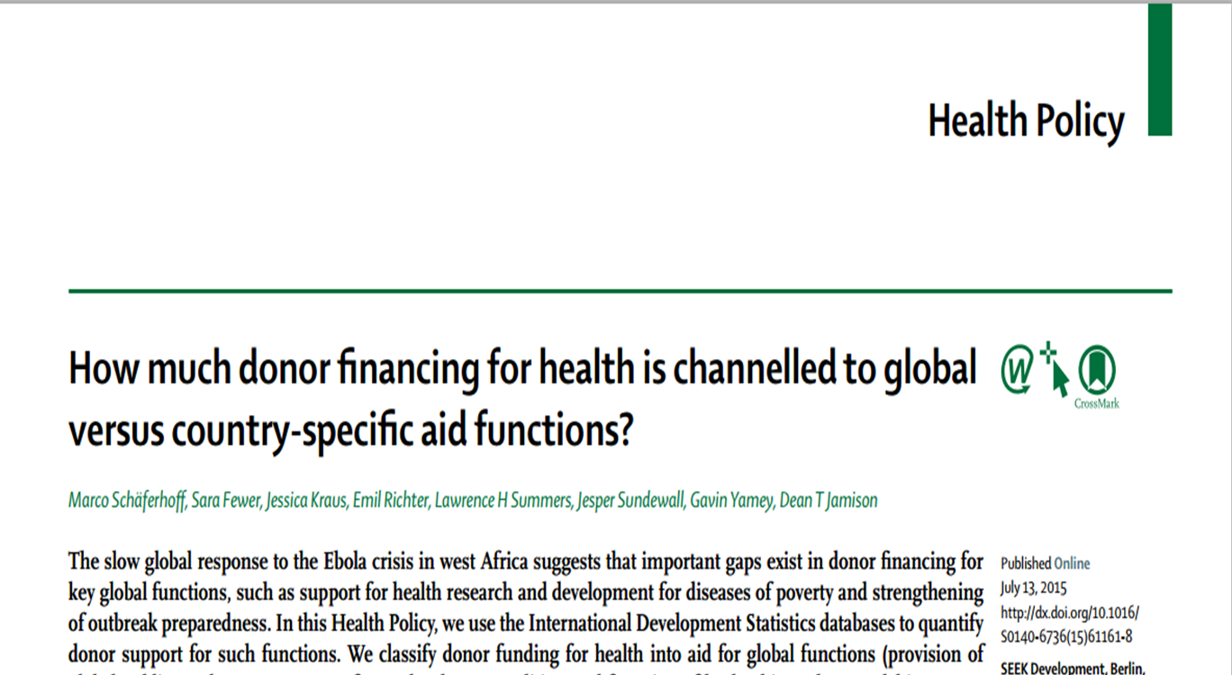

Slide 10
Rationale for new study
Previous research (e.g. IHME) has tracked donor funding to specific diseases and geographical regions, but no in-depth studies have tracked donor funding for global health functions.
Understanding flows to global versus country-specific functions could help to identify important underfunded areas for future donor investment.
Investments in global functions may lead to increased effectiveness and efficiency of health aid.
Understanding of extent to which donors focus country-specific support on low-income vs. middle-income countries will be important to guide aid investments in the post-2015 era.
The ongoing Equitable Access Initiative (EAI) addresses issues of future aid allocation but risks focusing discussion on formulas for allocating country-specific aid.

Slide 11
ODA+ for health: A more comprehensive picture of donor support for health
Health official development assistance (OECD DAC)
Additional funding for neglected disease R&D (G-FINDER)
ODA+
OECD DAC, Creditor Reporting System (CRS), 2013
Bilateral health disbursements, using sector codes for health
Health sector core contributions to multilaterals and partnerships
Policy Cures G-FINDER database, 2013
Public spending for pharmaceutical R&D for neglected diseases across assessed donors

Slide 12
Classification of donor financing for health
Function | Examples
GLOBAL FUNCTIONS
Supplying global public goods (GPGs) | R&D for health tools Development and harmonization of international health regulations Knowledge generation and sharing Intellectual property sharing Market-shaping activities
Managing cross-border externalities | Outbreak preparedness and response Responses to antimicrobial resistance Responses to marketing of unhealthful products Control of cross-border disease movement
Fostering leadership & stewardship | Health advocacy and priority setting Promotion of aid effectiveness and accountability
COUNTRY-SPECIFIC FUNCTIONS
Direct support to low- and middle-income countries | Achieving convergence Controlling NCDs and injuries Health-systems strengthening

Slide 13
Multilaterals and global functions
Multilateral | Estimated % for global functions
Gavi | 20%
Global Fund | 10%
IDA | 5%
Regional development banks | 5%
UNAIDS | 40%
UNFPA | 22%
UNICEF | 12%
WHO | 62%
Other multilateral organizations | 5%

Slide 14
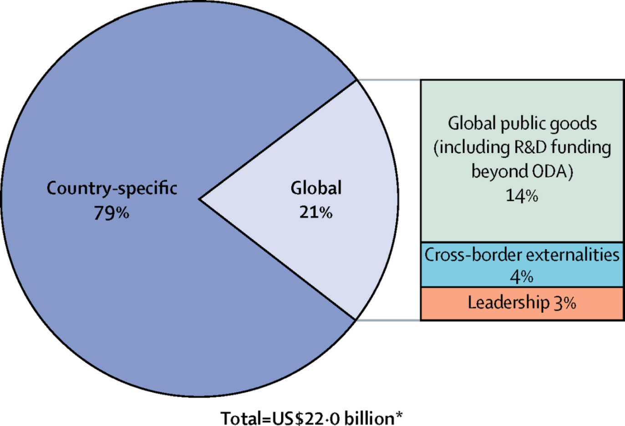
ODA+ for health:
Global vs. country-specific functions
Donor spending for ODA+ for health was $22 billion (USD) in 2013.

Slide 15
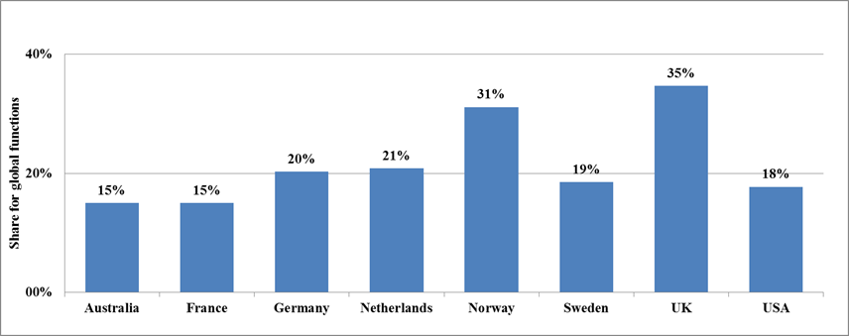
Spending on global functions by eight donors, 2013, as a % of total ODA+ for health

Slide 16
Policy Implications
Strengthen support for global functions
  Only one-fifth of ODA+ for health is for all global functions
  As countries graduate from donor support, shift aid towards global functions
  Efficient way to address “middle-income dilemma”
Selective support to middle-income countries for vulnerable groups and politically problematic services
Support health service delivery in the poorest countries

Slide 17
Allocation of education aid
Very initial analysis of development assistance for education sector for 8 of the largest education donors shows even less spending for global functions and weak pro-poor focus
Source: Schäferhoff et al, 2015

Slide 18
Functional aid flows team
Rifat Atun, Harvard University
Eran Bendavid, Stanford University
Nathan Blanchet, Results for Development
Sara Fewer, University of California, San Francisco
Robert Hecht, Results for Development
Dean T. Jamison, University of California, San Francisco
Keely Jordan, University of California, San Francisco
Felicia Knaul, University of Miami
Jessica Kraus, SEEK Development
Emil Richter, SEEK Development
Helen Saxenian, Results for Development
Marco Schäferhoff, SEEK Development
Christina Schrade, SEEK Development
Milan Thomas, Harvard University
Lawrence H. Summers, Harvard University
Jesper Sundewall, Expert Group for Aid Studies, Sweden
Milan Thomas, Results for Development
Gavin Yamey, Duke University

Slide 19
Thank you
GlobalHealth2035.org
@globlhealth2035
@LHSummers
#GH2035

